Slide 1
Syntax Analysis
Part I

Slide 2
Phases of a Compiler
Source program
Lexical analyzer
Syntax analyzer
Symbol table
manager
Semantic analyzer
Error handler
Intermediate code generator
Code optimizer
Code generator

Slide 3
Syntax Analyzer
Syntax Analyzer creates the syntactic structure of the given source program.
This syntactic structure is mostly a parse tree.
Syntax Analyzer is also known as parser.
The syntax of a programming is described by a context-free grammar (CFG) or BNF (Backus-Naur Form) notation.

Slide 4
Syntax Analyzer
The syntax analyzer (parser) checks whether a given source program satisfies the rules implied by a Context-Free Grammar (CFG) or not.
  If it satisfies, the parser creates the parse tree of that program.
  Otherwise the parser gives the error messages.
A CFG
  gives a precise syntactic specification of a programming language.
  the design of the grammar is an initial phase of the design of a compiler.
A CFG G can be represented by four components, denoted G=(V,T, P,S)
  V is the set of variables
  T is the set of terminals
  P is the set of production rules
  S is the start symbol.

Slide 5
Parser
source
Lexical
Analyzer
token
syntax
Semantic
Analyzer
Parser
code
tree
next token
Symbol
Table

Slide 6
Parsers (cont.)
Parsers can be categorized into two groups:
  Top-Down Parser
  the parse tree is created top to bottom, starting from the root.
  Bottom-Up Parser
  the parse tree is created bottom to top; starting from the leaves
Both top-down and bottom-up parsers scan the input from left to right (one symbol at a time).
Efficient top-down and bottom-up parsers can be implemented only for sub-classes of context-free grammars.
  LL for top-down parsing ( Left to right scan, Left most derivation)
  LR for bottom-up parsing ( Left to right scan, Right most derivation)

Slide 7
Context-Free Grammars
In a context-free grammar, we have:
  A finite set of terminals
  A finite set of non-terminals
  A finite set of production rules of the form
    A → α
    where A is a non-terminal and α is a string of terminals and non-terminals (including the empty string)
  A start symbol (one of the non-terminal symbol)
Example:
  E → E + E | E – E | E * E | E / E | - E
  E → ( E )
  E → id

Slide 8
CFG: An Example
Terminals: id, ‘+’, ‘-’, ‘*’, ‘/’, ‘(’, ‘)’
Nonterminals: expr, op
Productions:
expr → expr op expr
expr → ‘(’ expr ‘)’
expr → ‘-’ expr
expr → id
op → ‘+’ | ‘-’ | ‘*’ | ‘/’
The start symbol: expr

Slide 9
Notational Conventions in CFG
a, b, c, … [+-0-9], id: symbols are terminals
A, B, C,…,S, expr,stmt: symbols are non terminals
U, V, W,…,X,Y,Z: grammar symbols
α, β, γ,…denotes strings of grammar symbols
u, v, w,… denotes strings of terminals

Slide 10
Context-Free Grammars
A set of terminals: basic symbols from which sentences are formed
A set of nonterminals: syntactic variables denoting set of strings
A set of productions: rules specifying how the terminals and nonterminals can be combined to form sentences
The start symbol: a distinguished nonterminal denoting the language

Slide 11
CFG - Terminology
L(G) is the language of G (the language generated by G) which is a set of sentences.
A sentence of L(G) is a string of terminal symbols of G.
If S is the start symbol of G then
  ω is a sentence of L(G) iff S ⇒ ω where ω is a string of terminals of G.
If G is a context-free grammar, L(G) is a context-free language.
Two grammars are equivalent if they produce the same language.
S ⇒ α
  If α contains non-terminals, it is called a sentential form of G.
  If α does not contain non-terminals, it is called a sentence of G.
+
*

Slide 12
Derivation Example
E ⇒ -E ⇒ -(E) ⇒ -(E+E) ⇒ -(id+E) ⇒ -(id+id)
OR
E ⇒ -E ⇒ -(E) ⇒ -(E+E) ⇒ -(E+id) ⇒ -(id+id)
At each derivation step, we can choose any of the non-terminal in the sentential form of G for the replacement.
If we always choose the left-most non-terminal in each derivation step, this derivation is called as left-most derivation.
If we always choose the right-most non-terminal in each derivation step, this derivation is called as right-most derivation.

Slide 13
Left-Most and Right-Most Derivations
Left-Most Derivation
E ⇒ -E ⇒ -(E) ⇒ -(E+E) ⇒ -(id+E) ⇒ -(id+id)
Right-Most Derivation
E ⇒ -E ⇒ -(E) ⇒ -(E+E) ⇒ -(E+id) ⇒ -(id+id)
We will see
  the top-down parsers try to find the left-most derivation of the given source program.
  the bottom-up parsers try to find the right-most derivation of the given source program in the reverse order.
lm
lm
lm
lm
lm
rm
rm
rm
rm
rm

Slide 14
Parse Tree
Inner nodes of a parse tree are non-terminal symbols.
The leaves of a parse tree are terminal symbols.
A parse tree can be seen as a graphical representation of a derivation.
E ⇒ -E
E
⇒ -(E)
E
E
⇒ -(E+E)
-
E
-
E
-
E
(
E
)
(
E
)
E
E
E
+
E
-
E
-
E
⇒ -(id+E)
⇒ -(id+id)
(
E
)
(
E
)
E
+
E
E
+
E
id
id
id

Slide 15
Ambiguity
A grammar produces more than one parse tree for a sentence is
called as an ambiguous grammar.
E
E
+
E
E ⇒ E+E ⇒ id+E ⇒ id+E*E
⇒ id+id*E ⇒ id+id*id
id
E
*
E
id
id
E
E
*
E
E ⇒ E*E ⇒ E+E*E ⇒ id+E*E
⇒ id+id*E ⇒ id+id*id
E
+
E
id
id
id

Slide 16
Ambiguity (cont.)
For the most parsers, the grammar must be unambiguous.
unambiguous grammar posses the unique selection of the parse tree for a sentence
We should eliminate the ambiguity in the grammar during the design phase of the compiler.
We have to prefer one of the parse trees of a sentence (generated by an ambiguous grammar) to disambiguate that grammar to restrict to this choice.

Slide 17
Ambiguity (cont.)
if (x > 0)
if (y > 0)
print("A");
else
print("B");
which if does that else belong to?
Does it belong to the first if?
Or the second if?
This is called the dangling else problem.

Slide 18
Ambiguity (cont.)
stmt → if expr then stmt |
if expr then stmt else stmt | otherstmts
stmt
if expr then stmt else stmt
E₁ if expr then stmt S₂
E₂ S₁
if E₁ then if E₂ then S₁ else S₂
stmt
if expr then stmt
E₁ if expr then stmt else stmt
E₂ S₁ S₂
1
2

Slide 19
Ambiguity (cont.)
We prefer the second parse tree (else matches with closest if).
So, we have to disambiguate our grammar to reflect this choice.
The unambiguous grammar will be:
stmt → matchedstmt | unmatchedstmt
matchedstmt → if expr then matchedstmt else matchedstmt
| otherstmts
unmatchedstmt → if expr then stmt |
if expr then matchedstmt else unmatchedstmt

Slide 20
Ambiguity – Operator Precedence
Ambiguous grammars (because of ambiguous operators) can be disambiguated according to the precedence and associativity rules.
E → E+E | E*E | E^E | id | (E)
disambiguate the grammar
precedence: ^ (right to left)
* (left to right)
+ (left to right)
E → E+T | T
T → T*F | F
F → G^F | G
G → id | (E)
⇓

Slide 21
Ambiguity – Operator Precedence
Ambiguous grammars (because of ambiguous operators) can be disambiguated according to the precedence and associativity rules.
E → E+E | E*E | E^E | id | (E)
disambiguate the grammar
precedence: ^ (right to left)
* (left to right)
+ (left to right)
E → E+T | T
T → T*F | F
F → G^F | G
G → id | (E)
⇓

Slide 22
Ambiguity – Associativity
If the same precedence operators are in production, we must examine their associativity.
If the associativity is left to right, we must initiate a left recursion in the production. The parse tree will be left-recursive and grow on the left side.
  +, -, *, and / are left associative operators.
If the associativity is right to left, we must prompt the appropriate recursion in the productions. The parse tree will also be right-recursive, growing on the right side.
  ^ denotes a right associative operator.

Slide 23
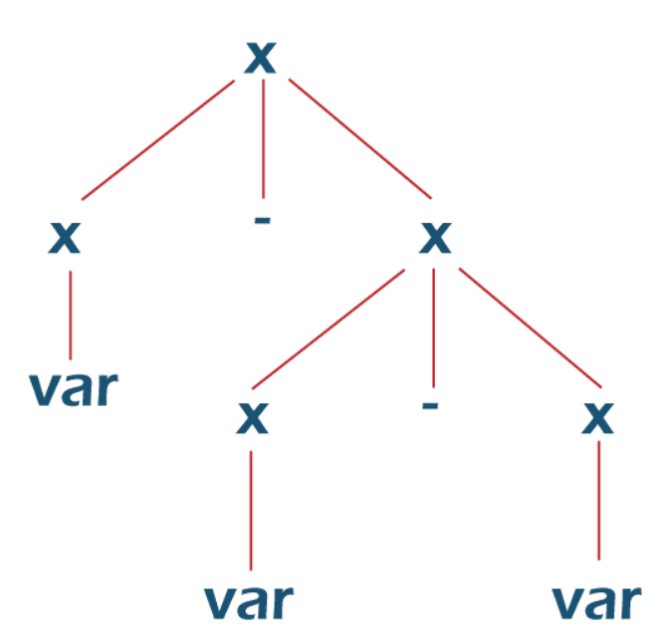
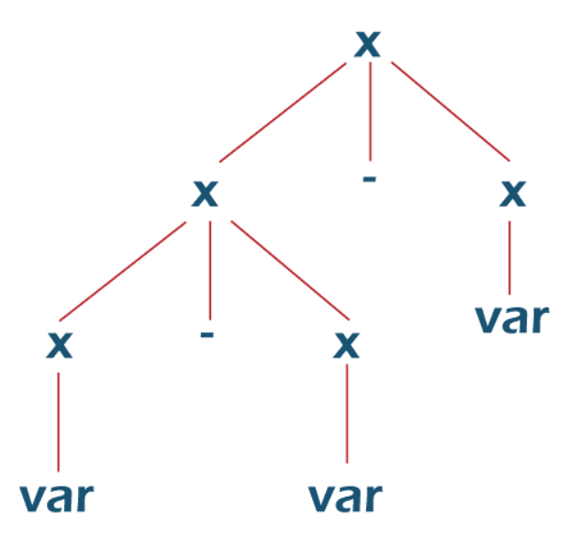
Ambiguity – Associativity
Grammer:
X -> X - X
X -> var/const
String: “a-b-c”

Slide 24
Ambiguity – Associativity
Grammer:
X -> X - P/P
P -> var/ const
String: “a-b-c”
Corrected Grammer:
X -> X - P
X - X - P
P - P - var
var - var - var
a-b-c
String: “a-b-c”

Slide 25
Left Recursion
A grammar is left recursive if it has a non-terminal A such that there is a derivation
A ⇒ Aα for some string α
Top-down parsing techniques cannot handle left-recursive grammars.
So, we have to convert left-recursive grammar into an equivalent grammar which is not left-recursive.
The left-recursion may appear in a single step of the derivation (immediate left-recursion), or may appear in more than one step of the derivation.
+

Slide 26
Eliminate Left-Recursion
A → A α | β where β does not start with A
⇓ eliminate immediate left recursion
A → β A′
A′ → α A ′ | ε an equivalent grammar

Slide 27
Immediate Left-Recursion - Example
E → E+T | T
T → T*F | F
F → id | (E)
⇓ eliminate immediate left recursion
E → TE′
E′ → +TE′ | ε
T → FT′
T’ → *FT′ | ε
F → id | (E)

Slide 28
Immediate Left-Recursion
In general,
A → A α₁ | ... | A α_{m} | β₁ | ... | β_{n} where β₁ ... β_{n} do not start with A
⇓ eliminate immediate left recursion
A → β₁ A′ | ... | β_{n} A ′
A′ → α₁ A′ | ... | α_{m} A′ | ε an equivalent grammar

Slide 29
Left-Recursion -- Problem
A grammar cannot be immediately left-recursive, but it still can be
left-recursive.
By just eliminating the immediate left-recursion, we may not get
a grammar which is not left-recursive.
S → Aa | b
A → Ac |Sd | ε This grammar is not immediately left-recursive,
but it is still left-recursive.
S ⇒ Aa ⇒ Sda or
A ⇒ Sd ⇒ Aad causes to a left-recursion
So, we have to eliminate all left-recursions from this grammar

Slide 30
Eliminate Left-Recursion -- Example
S → Aa | b
A → Ac | Sd | f
- Order of non-terminals: S, A
for S:
- we do not enter the inner loop.
- there is no immediate left recursion in S.
for A:
- Replace A → Sd with A → Aad | bd
So, we will have A → Ac | Aad | bd | f
- Eliminate the immediate left-recursion in A
A → bdA′ | fA′
A’ → cA′ | adA′ | ε
So, the resulting equivalent grammar which is not left-recursive is:
S → Aa | b
A → bdA′ | fA′
A’ → cA′ | adA′ | ε

Slide 31
Eliminate Left-Recursion – Example2
S → Aa | b
A → Ac | Sd | f
- Order of non-terminals: A, S
for A:
- Eliminate the immediate left-recursion in A
A → SdA’ | fA’
A’ → cA’ | ε
for S:
- Replace S → Aa with S → SdA’a | fA’a
So, we will have S → SdA’a | fA’a | b
- Eliminate the immediate left-recursion in S
S → fA’aS’ | bS’
S’ → dA’aS’ | ε
So, the resulting equivalent grammar which is not left-recursive is:
S → fA’aS’ | bS’
S’ → dA’aS’ | ε
A → SdA’ | fA’
A’ → cA’ | ε

Slide 32
Left-Factoring
A predictive parser (a top-down parser without backtracking) insists that the grammar must be left-factored.
stmt → if expr then stmt else stmt |
if expr then stmt
when we see if, we cannot know which production rule to choose to re-write stmt in the derivation.

Slide 33
Left-Factoring (cont.)
In general,
A → αβ₁ | αβ₂
where α is non-empty and the first symbols of β₁ and β₂ (if they have one)are different.
when processing α we cannot know whether expand
A to αβ₁ or A to αβ₂
But, if we re-write the grammar as follows
A → αA ′
A′ → β₁ | β₂
so, we can immediately expand A to αA ′

Slide 34
Left-Factoring -- Algorithm
For each non-terminal A with two or more alternatives (production rules) with a common non-empty prefix,
A → αβ₁ | ... | αβ_{n} | γ₁ | ... | γ_{m}
convert it into
A → αA′ | γ₁ | ... | γ_{m}
A’ → β₁ | ... | β_{n}

Slide 35
Left-Factoring – Example 1
A → abB | aB | cdg | cdeB | cdfB
⇓
A → aA′ | cdg | cdeB | cdfB
A′ → bB | B
⇓
A → aA′ | cdA′′
A′ → bB | B
A′′ → g | eB | fB

Slide 36
Left-Factoring – Example 2
A → ad | a | ab | abc | b
⇓
A → aA′ | b
A′ → d | ε | b | bc
⇓
A → aA′ | b
A′ → d | ε | bA′′
A′′ → ε | c

Slide 37
Syntax Analysis
Part II

Slide 38
Phases of a Compiler
Source program
Lexical analyzer
Syntax analyzer
Symbol table
manager
Semantic analyzer
Error handler
Intermediate code generator
Code optimizer
Code generator

Slide 39
Top-Down Parsing
The parse tree is created top to bottom.
Top-down parser
  Recursive-Descent Parsing
    Backtracking is needed
      If a choice of a production rule does not work, we backtrack to try other alternatives.
    It is a general parsing technique, but not widely used.
    Not efficient
  Predictive Parsing
    no backtracking
    efficient
    needs a special form of grammars (LL(1) grammars). (LL- Left to right scan, Left derivation )
    Non-Recursive (Table Driven) Predictive Parser is also known as LL(1) parser.

Slide 40
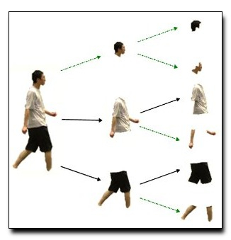
Top-Down Parsing

Slide 41
Predictive Parser
A grammar
  Eliminate ambiguity
  eliminate left recursion
  left factor
  suitable for predictive parsing (LL(1))
Given the input symbol a, the non terminal A to be expand
A → α₁ | ... | α_{n}
will be the unique alternatives with first symbol a.

Slide 42
LL(k) Parsing
The first L stands for scanning the input from left to right
The second L stands for producing a leftmost derivation
The k stands for the number of input symbols for look ahead used to choose alternative productions at each derivation step
Notes:
A large number of TD parsing can be generalized as LL(1), in which … we scan strictly left-to-right, thus derives the sentential form in lm.

Slide 43
Non-Recursive Predictive Parsing -- LL(1) Parser
Non-Recursive predictive parsing is a table-driven parser.
It is a top-down parser.
It is also known as LL(1) Parser.
input buffer
stack Non-recursive output
Predictive Parser
Parsing Table

Slide 44
Non recursive Predictive Parsing
a | b | c | … | x | y | $
Input
X
_{Y}
Z
$
Predictive Parsing
Program
Output
Stack
Parsing table

Slide 45
LL(1) Parser
input buffer
  our string to be parsed. We will assume that its end is marked with a special symbol $.
output
  a production rule representing a step of the derivation sequence (left-most derivation) of the string in the input buffer.
stack
  contains the grammar symbols
  at the bottom of the stack, there is a special end marker symbol $.
  initially the stack contains only the symbol $ and the starting symbol S.
  when the stack is emptied (ie. only $ left in the stack), the parsing is completed.

Slide 46
LL(1) Parser
parsing table
  a two-dimensional array M[A,a]
  each row is a non-terminal symbol
  each column is a terminal symbol or the special symbol $
  each entry holds a production rule.
 | a | b | $
S | S → aBa
B | B → ε | B → bB

Slide 47
LL(1) Parser – Parser Actions
The symbol at the top of the stack (say X) and the current symbol in the input string (say a) determine the parser action.
There are four possible parser actions.
If (X = $, a = $ ) parser halts (successful completion)
If X= a (but not $)
parser pops X from the stack, and moves the next symbol in the input buffer.

Slide 48
LL(1) Parser – Parser Actions
If X is a non-terminal
  parser looks at the parsing table entry M[X, a].
  If M[X, a] holds a production rule X→Y₁Y₂...Y_{k}, it pops X from the stack and pushes Y_{k},Y_{k-1},...,Y₁ into the stack.
  The parser also outputs the production rule X→Y₁Y₂...Y_{k} to represent a step of the derivation.
none of the above : error
  all empty entries in the parsing table are errors.
  If X is a terminal symbol different from a, this is also an error case.

Slide 49
LL(1) Parser – Example1
 | a | b | $
S | S → aBa
B | B → ε | B → bB
S → aBa
B → bB | ε
stack input output
$S abba$ S → aBa
$aBa abba$
$aB bba$ B → bB
$aBb bba$
$aB ba$ B → bB
$aBb ba$
$aB a$ B → ε
$a a$
$ $ accept, successful completion

Slide 50
LL(1) Parser – Example1 (cont.)
Outputs: S → aBa B → bB B → ε
Derivation(left-most): S⇒aBa⇒abBa⇒abbBa⇒abba
S
parse tree
a
B
a
b
B
b
B
ε

Slide 51
Constructing LL(1) Parsing Tables
Two functions are important in the construction of LL(1) parsing tables:
  FIRST
  FOLLOW
FIRST(α) is a set of terminal symbols which occur as first symbols in strings derived from α.
  where α is any string of grammar symbols.
  if α derives to ε, then ε is also in FIRST(α) .
FOLLOW(A) is the set of terminals which occur immediately after the non-terminal A in the strings derived from the starting symbol.
  terminal a is in FOLLOW(A) if S ⇒ αAaβ
  $ is in FOLLOW(A) if S ⇒ αA
*
*

Slide 52
Computing FIRST for Any String X
If X is a terminal then First(X) ={X}
If there is a Production X → ε then add ε to first(X)
If there is a Production X → Y₁Y₂…Y_{k} then add first(Y₁Y₂…Yk) to first(X)
  First(Y1Y2...Y_{k}) is either
    First(Y1) (if Y1 doesn't derive to ε)
    Or if Y1 derive to ε
      Add First (Y1) <except for ε > as well as everything in First(Y2…Yk) . And so on…
    If First(Y1) First(Y2)...First(Yk) all contain ε then add ε to First(Y1Y2..Yk) as well.

Slide 53
FIRST Example(1)
E → TE’
E’ → +TE’ | ε
T → FT’
T’ → *FT’ | ε
F → (E) | id
FIRST(F) = {(,id} FIRST(TE’) = {(,id}
FIRST(T’) = {*, ε} FIRST(+TE’ ) = {+}
FIRST(T) = {(,id} FIRST(ε) = {ε}
FIRST(E’) = {+, ε} FIRST(FT’) = {(,id}
FIRST(E) = {(,id} FIRST(*FT’) = {*}
FIRST((E)) = {(}
FIRST(id) = {id}

Slide 54
FIRST Example(2)
E → TE’
E’ → +TE’ | ε
T → FT’
T’ → *FT’ | ε
F → (E) | id
FIRST(E) = {} FIRST(E') = {} FIRST(T) = {} FIRST(T') = {} FIRST(F) = {} | FIRST(E) = {} FIRST(E') = {+,ε} FIRST(T) = {} FIRST(T') = {*,ε} FIRST(F) = {} | apply rule 3 to T → FT‘ First(F) FIRST(E) = {} FIRST(E') = {+,ε} FIRST(T) = {'(',id} FIRST(T') = {*,ε} FIRST(F) = {'(',id}
FIRST(E) = {} FIRST(E') = {ε} FIRST(T) = {} FIRST(T') = {ε} FIRST(F) = {} | FIRST(E) = {} FIRST(E') = {+,ε} FIRST(T) = {} FIRST(T') = {*,ε} FIRST(F) = {'(',id} | FIRST(E) = {'(',id} FIRST(E') = {+,ε} FIRST(T) = {'(',id} FIRST(T') = {*,ε} FIRST(F) = {'(',id}

Slide 55
FIRST Example (3)
S -> ABC | ghi | jkl
A -> a | b | c
B -> b
D -> d
S -> ABC
A -> a | b | ε
B -> c | d | ε
C -> e | f | ε

Slide 56
Computing FOLLOW for non-terminals
Follow(A) contains set of all terminals present immediate in right of ‘A’.
First put $ in Follow(S) (S is the start symbol)
If there is a production A → αBβ, then everything in FIRST(β ) except for ε is placed in FOLLOW(B).
If there is a production A → αB, then everything in FOLLOW(A) is in FOLLOW(B)
If there is a production A → αBβ, where FIRST(β) contains ε, then everything in FOLLOW(A) is in FOLLOW(B)

Slide 57
Examples
2. S-> aSbS | bSaS | ε
Find the Follow(S)?
S -> ACD
C -> a|b
Follow(S) = {$, b, a}
Follow(S) = {$}
Follow(A) = First(C) = {a,b}
Follow(D) = Follow(S) = {$}
Follow(C) = First(D) = {$}

Slide 58
Examples
4. S-> ABC
A -> DEF
B -> ε
C -> ε
D -> ε
E -> ε
F -> ε
Find Follow(A) ?
3. S -> AaAb | BbBa
A -> ε
B -> ε
Find the Follow(A) and Follow(B)?
Follow(A) = {a,b}
Follow(B) = {a, b}
Follow(A) = First(B) = First(C) =Follow(S) = {$}

Slide 59
FOLLOW Example
E → TE’
E’ → +TE’ | ε
T → FT’
T’ → *FT’ | ε
F → (E) | id
FOLLOW(E) = { $, ) }
FOLLOW(E’) = { $, ) }
FOLLOW(T) = { +, ), $ }
FOLLOW(T’) = { +, ), $ }
FOLLOW(F) = {+, *, ), $ }

Slide 60
FOLLOW Example
List the sets we need FOLLOW(E) = {} FOLLOW(E') = {} FOLLOW(T) ={} FOLLOW(T') = {} FOLLOW(F) = {} | Apply rule 2 to E' →+TE‘ “Everything in First(E') except ε be in Follow(T)” FOLLOW(E) = {$} FOLLOW(E') = {} FOLLOW(T) ={+} FOLLOW(T') = {} FOLLOW(F) = {} | Apply rule 3 to T → FT‘ “add everything in Follow(T) into Follow(T')” FOLLOW(E) = {$} FOLLOW(E') = {$} FOLLOW(T) ={+} FOLLOW(T') = {+} FOLLOW(F) = {}
apply rule 2 to T' →*FT‘ add everything in First(T') except for ε in Follow(F) FOLLOW(E) = {$} FOLLOW(E') = {$} FOLLOW(T) ={+} FOLLOW(T') = {+} FOLLOW(F) = {*} | apply rule 2 to F → (E). add everything in First(')') in Follow(E) FOLLOW(E) = {$,)} FOLLOW(E') = {$} FOLLOW(T) ={+} FOLLOW(T') = {+} FOLLOW(F) = {*} | apply rule 4 to E' → +TE‘. add everything in Follow(E') into Follow(T) (because First(E') contains ε) FOLLOW(E) = {$,)} FOLLOW(E') = {$,)} FOLLOW(T) = {+,$,)} FOLLOW(T') = {+} FOLLOW(F) = {*}

Slide 61
FOLLOW Example
apply rule 3 to E → TE‘. add everything in Follow(E) into Follow(E') FOLLOW(E) = {$,)} FOLLOW(E') = {$,)} FOLLOW(T) = {+} FOLLOW(T') = {+} FOLLOW(F) = {*} | apply rule 3 to T → FTadd everything in Follow(T) into Follow(T') FOLLOW(E) = {$,)} FOLLOW(E') = {$,)} FOLLOW(T) = {+,$,)} FOLLOW(T') = {+,$,)} FOLLOW(F) = {*} | Finaly we apply rule 4 to T' → *FT‘. add everything in Follow(T') into Follow(F) FOLLOW(E) = {$,)} FOLLOW(E') = {$,)} FOLLOW(T) = {+,$,)} FOLLOW(T') = {+,$,)} FOLLOW(F) = {*,+,$,)}

Slide 62
Constructing LL(1) Parsing Table -- Algorithm
for each production rule A → α of a grammar G
  for each terminal a in FIRST(α) ➔ add A → α to M[A,a]
  If ε in FIRST(α) ➔ for each terminal a in FOLLOW(A) add A → α to M[A,a]
  If ε in FIRST(α) and $ in FOLLOW(A) ➔ add A → α to M[A,$]
All other undefined entries of the parsing table are error entries.

Slide 63
Constructing LL(1) Parsing Table -- Example
E → TE’ FIRST(TE’)={(,id} ➔ E → TE’ into M[E,(] and M[E,id]
E’ → +TE’ FIRST(+TE’ )={+} ➔ E’ → +TE’ into M[E’,+]
E’ → ε FIRST(ε)={ε} ➔ none
but since ε in FIRST(ε)
and FOLLOW(E’)={$,)} ➔ E’ → ε into M[E’,$] and M[E’,)]
T → FT’ FIRST(FT’)={(,id} ➔ T → FT’ into M[T,(] and M[T,id]
T’ → *FT’ FIRST(*FT’ )={*} ➔ T’ → *FT’ into M[T’,*]
T’ → ε FIRST(ε)={ε} ➔ none
but since ε in FIRST(ε)
and FOLLOW(T’)={$,),+}➔ T’ → ε into M[T’,$], M[T’,)] and M[T’,+]
F → (E) FIRST((E) )={(} ➔ F → (E) into M[F,(]
F → id FIRST(id)={id} ➔ F → id into M[F,id]

Slide 64
LL(1) Grammars
The parsing table of a grammar may contain more than one production rule i.e. multiple defined. This is possible if G is left recursive or ambiguous.
In this case, we say that it is not a LL(1) grammar.
A grammar whose parsing table has no multiply-defined entries is said to be LL(1) grammar.

Slide 65
LL(1) Parser – Example2
E → TE′
E’ → +TE′ | ε
T → FT′
T’ → *FT′ | ε
F → (E) | id
FIRST(E) = {'(',id}
FIRST(E') = {+,ε}
FIRST(T) = {'(',id}
FIRST(T') = {*,ε}
FIRST(F) = {'(',id}
FOLLOW(E) = { $, ) }
FOLLOW(E’) = { $, ) }
FOLLOW(T) = { +, ), $ }
FOLLOW(T’) = { +, ), $ }
FOLLOW(F) = {+, *, ), $ }
 | id | + | * | ( | ) | $
E | E → TE’ |  |  | E → TE’
E’ |  | E’ → +TE’ |  |  | E’ → ε | E’ → ε
T | T → FT’ |  |  | T → FT’
T’ |  | T’ → ε | T’ → *FT’ |  | T’ → ε | T’ → ε
F | F → id |  |  | F → (E)

Slide 66
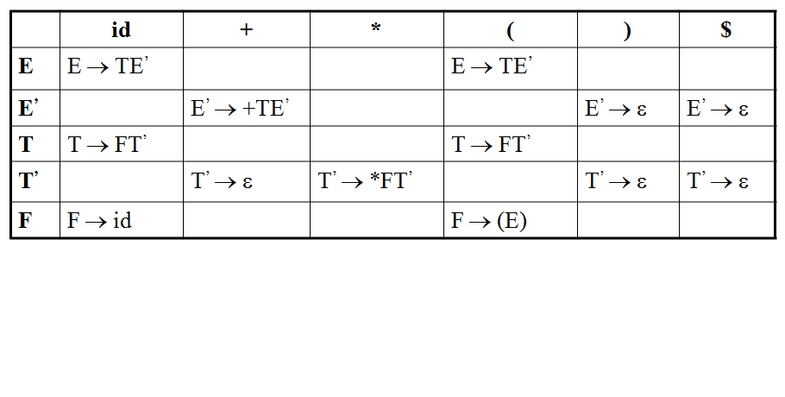
LL(1) Parser – Example2
stack input output
$E id+id$ E → TE’
$E’T id+id$ T → FT’
$E’ T’F id+id$ F → id
$ E’ T’id id+id$
$ E’ T’ +id$ T’ → ε
$ E’ +id$ E’ → +TE’
$ E’ T+ +id$
$ E’ T id$ T → FT’
$ E’ T’ F id$ F → id
$ E’ T’id id$
$ E’ T’ $ T’ → ε
$ E’ $ E’ → ε
$ $ accept

Slide 67
LL(1) Parser -Example3
Stack Input Output
$E id + id * id$
$E'T id + id * id$ E → TE'
$E'T'F id + id * id$ T → FT'
$E'T'id id + id * id$ F → id
$E'T' + id * id$
$E' + id * id$ T' → ε
$E'T+ + id * id$ E' → + TE'
$E'T id * id$
$E'T'F id * id$ T → FT'
$E'T'id id * id$ F → id
$E'T' * id$
$E'T'F* * id$ T' → * FT'
$E'T'F id$
$E'T'id id$ F → id
$E'T' $
$E' $ T' → ε
$ $ E' → ε

Slide 68
Syntax Analysis
Part II

Slide 69
LL(1) Grammars
The parsing table of a grammar may contain more than one production rule i.e. multiple defined. This is possible if G is left recursive or ambiguous.
In this case, we say that it is not a LL(1) grammar.
A grammar whose parsing table has no multiply-defined entries is said to be LL(1) grammar.

Slide 70
A Grammar which is not LL(1)
S → i C t S E | a FOLLOW(S) = { $,e }
E → e S | ε FOLLOW(E) = { $,e }
C → b FOLLOW(C) = { t }
FIRST(iCtSE) = {i}
FIRST(a) = {a}
FIRST(eS) = {e}
FIRST(ε) = {ε}
FIRST(b) = {b}
two production rules for M[E,e]
Problem ➔ ambiguity
 | a | b | e | i | t | $
S | S → a |  |  | S → iCtSE
E |  |  | E → e S E → ε |  |  | E → ε
C |  | C → b

Slide 71
A Grammar which is not LL(1) (cont.)
What do we have to do it if the resulting parsing table contains multiply defined entries?
  If we didn’t eliminate left recursion, eliminate the left recursion in the grammar.
  If the grammar is not left factored, we have to left factor the grammar.
  If its parsing table still contains multiply defined entries, that grammar is ambiguous or it is inherently not a LL(1) grammar.

Slide 72
Properties of LL(1) Grammars
A grammar G is LL(1) if and only if the following conditions hold for two distinctive production rules A → α and A → β
  Both α and β cannot derive strings starting with same terminals.
  At most one of α and β can derive to ε.
  If β can derive to ε, then α cannot derive to any string starting with a terminal in FOLLOW(A).

Slide 73
A Grammar which is not LL(1) (cont.)
A left recursive grammar cannot be a LL(1) grammar.
  A → Aα | β
    any terminal that appears in FIRST(β) also appears FIRST(Aα) because Aα ⇒ βα.
    If β is ε, any terminal that appears in FIRST(α) also appears in FIRST(Aα) and FOLLOW(A).
Above conditions indicates multiple entry in parse table.

Slide 74
A Grammar which is not LL(1) (cont.)
A grammar is not left factored, it cannot be a LL(1) grammar
  A → αβ₁ | αβ₂
    any terminal that appears in FIRST(αβ₁) also appears in FIRST(αβ₂). It indicates multiple entry in parse table.
An ambiguous grammar cannot be a LL(1) grammar.

